Slide 1
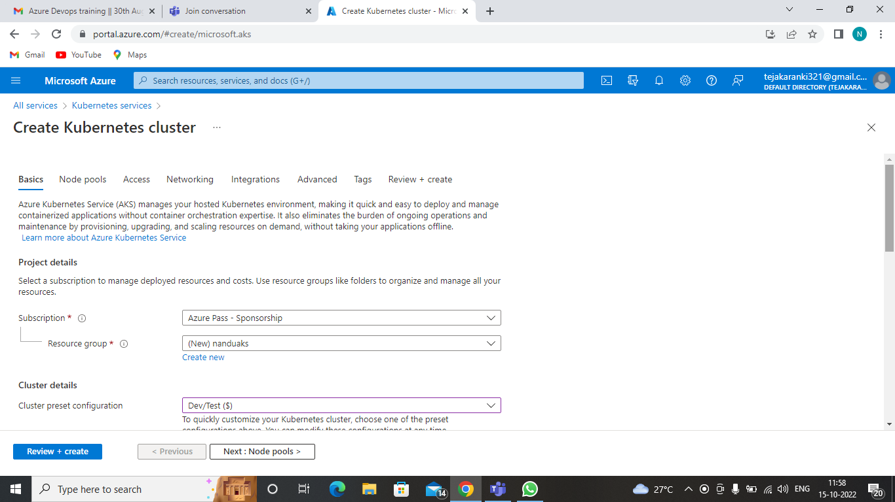
Deploy an application using AKS

Slide 2
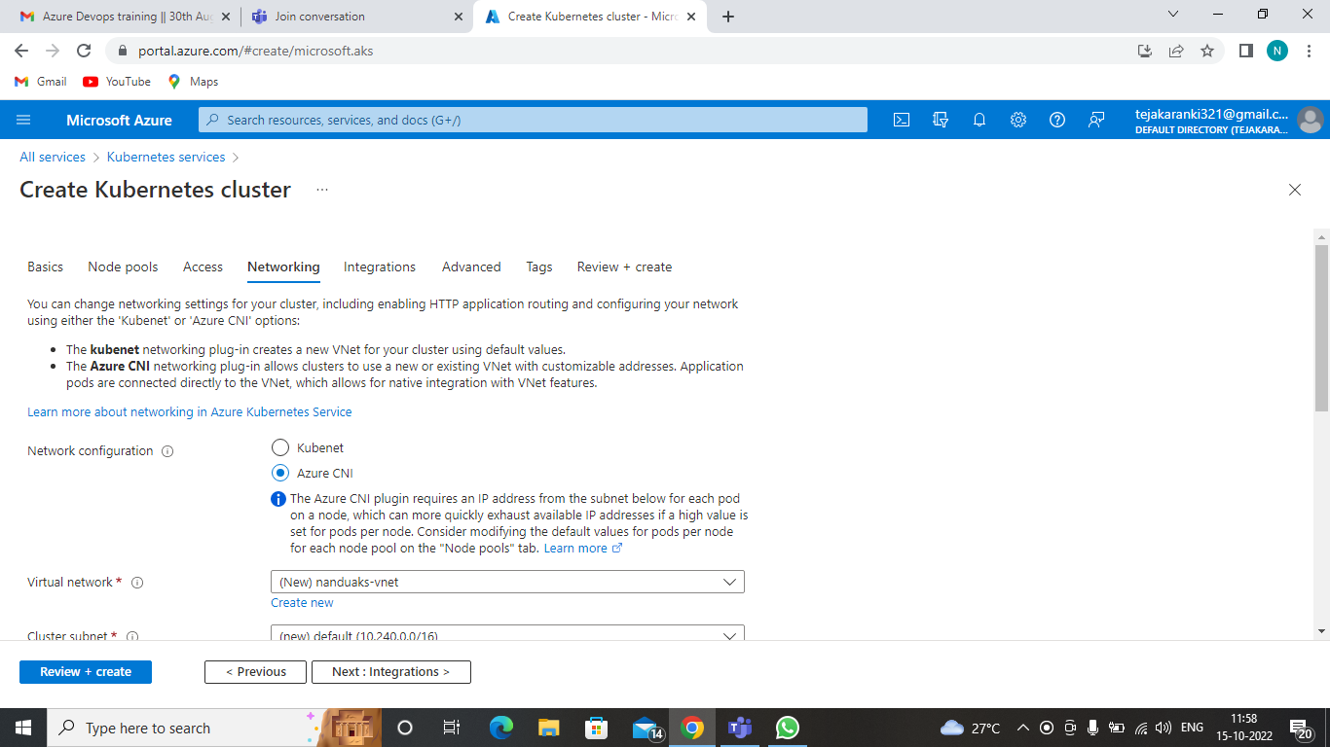
Networking --- Azure CNI

Slide 3
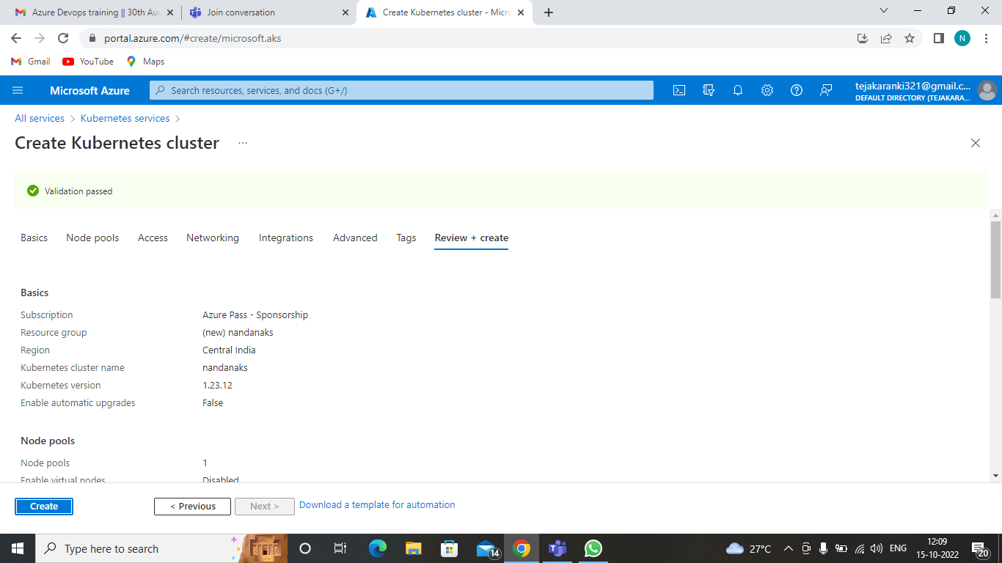
Reviewing and Creating

Slide 4
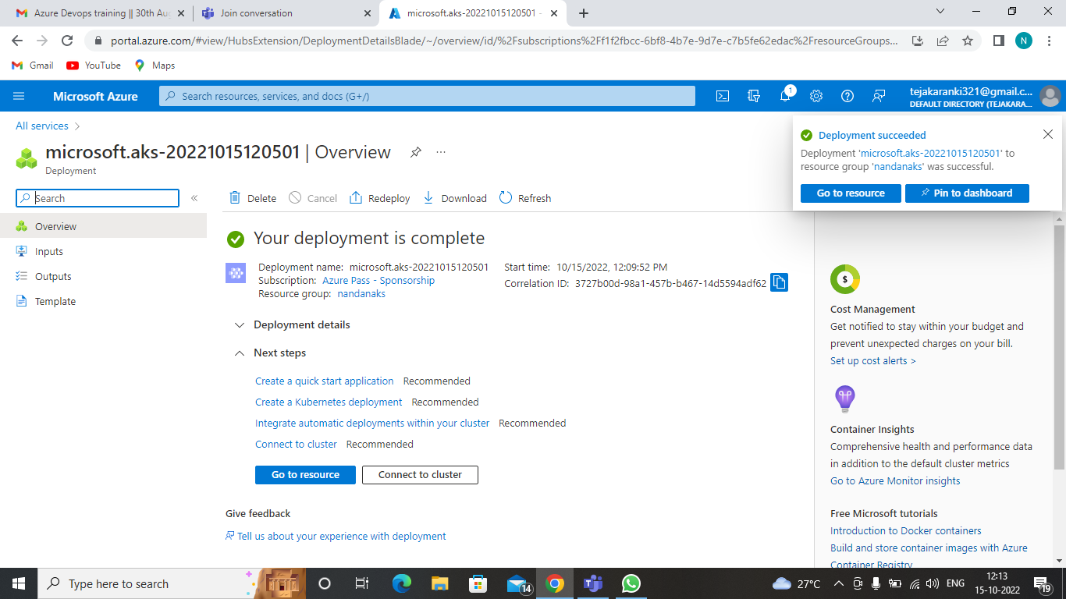
Deployment Completed

Slide 5
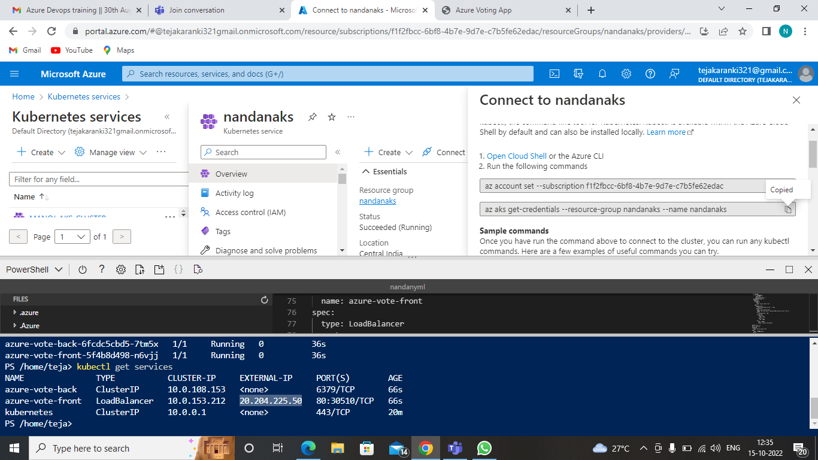
Connecting

Slide 6
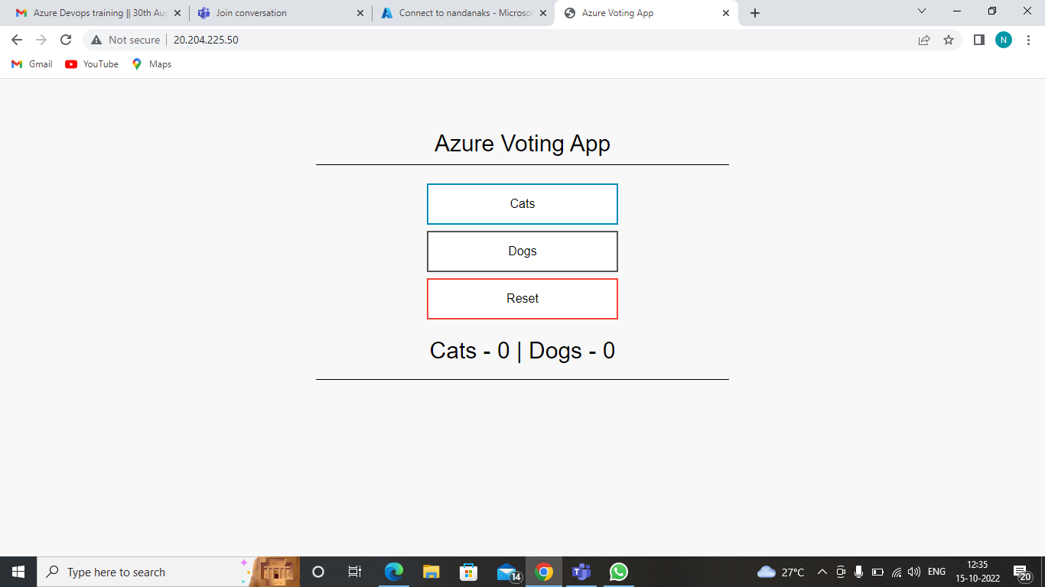
Output

Slide 7
Thank You

